Slide 1
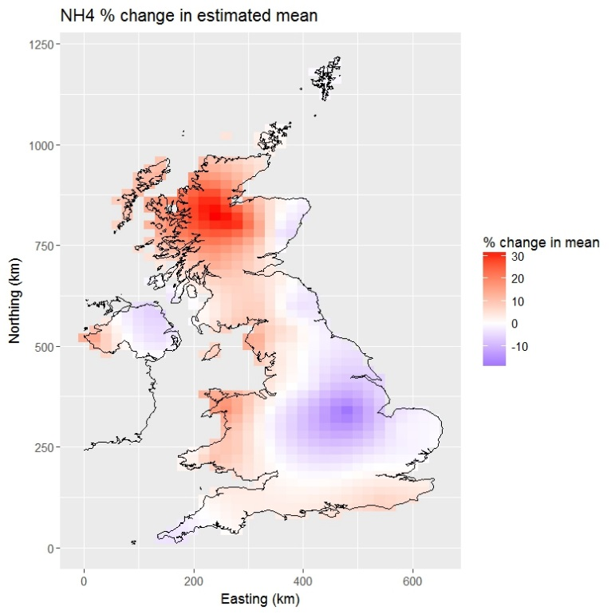
SPATIAL &
spatio-temporal
ANALYSIS – PART I
BAYESIAN COURSE, CEH SEPTEMBER 2019

Slide 2
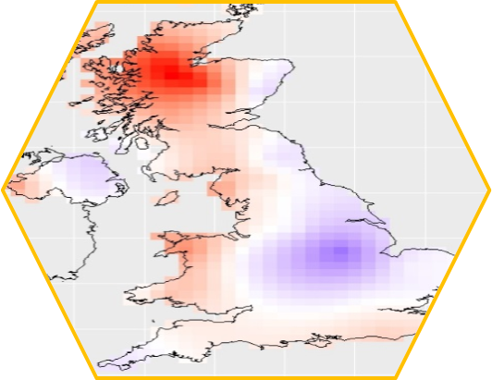
SPATIAL DATA ANALYSIS
SPATIAL & SPATIO-TEMPORAL
CONTENT & Learning outcomes
Spatial data types
Introduction to Geostatistics (focus on Gaussian data)
Why ‘go Bayesian’ for spatial/spatio-temporal problems
Examples
In practice (software/packages)

Slide 3
SPATIAL DATA ANALYSIS
SPATIAL & SPATIO-TEMPORAL
SPATIAL DATA ‘101’
Data collected in space
i.e. Sampling location is known and relevant
Space is of primary interest – we want to analyse and describe the spatial structure, how the data vary over space
Spatial structure is nuisance – we need to account for it in order to draw proper inference from our models (spatial autocorrelation)
Often data collected from more similar locations are more similar so are not independent
Upscaling

Slide 4
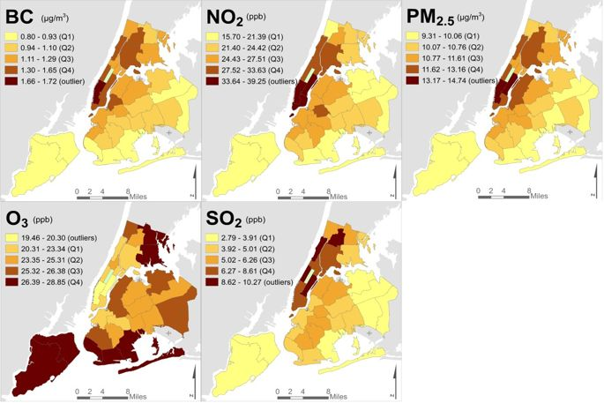
SPATIAL DATA Forms
SPATIAL & SPATIO-TEMPORAL
Areal data – partitioned region with discrete spatial units, each with one value

Slide 5
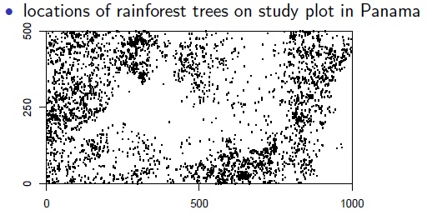
SPATIAL DATA Forms
SPATIAL & SPATIO-TEMPORAL
Areal data
Spatial point pattern data – Pattern formed by location of objects/events. Is the spatial pattern of points random or clustered/structured? Are the patterns determined by covariates?

Slide 6
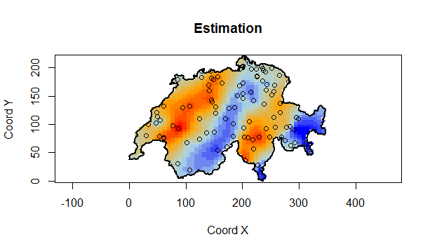
SPATIAL DATA Forms
SPATIAL & SPATIO-TEMPORAL
Areal data
Spatial point pattern data
Geostatistical data – spatially continuous phenomena, based on observations at a finite number of locations
Notes:
All these data can be analysed in a Bayesian way….we focus here on geostats

Slide 7
SPATIAL DATA Forms
SPATIAL & SPATIO-TEMPORAL
Areal data
Spatial point pattern data
Geostatistical data
Sometimes this is not our end-point -> covariates for other environmental/ecological processes
Notes:
All these data can be analysed in a Bayesian way….we focus here on geostats

Slide 8
geostatistics
SPATIAL & SPATIO-TEMPORAL
SAMPLES drawn from a CONTINUUM in space
Often a goal is to PREDICT values in intervening spaces
Without BIAS and MINIMISING UNCERTAINTY

Slide 9
geostatistics
SPATIAL & SPATIO-TEMPORAL
SPATIAL DEPENDENCE or CORRELATION
Correlations between sites are a function of distance
Typically, geostatistical data will display positive correlation
The closer two observations are the more similar their values are likely to be
Arises because variables of interest being affected by other unmeasured processes which are themselves spatially correlated
For example:
Air pollution
Soil nutrients
Your examples……

Slide 10
Why ‘go Bayesian’…
SPATIAL & SPATIO-TEMPORAL
…FOR GEOSTATISTICAL ANALYSIS
Correctly allows for variation in the parameters - Parameters of correlation function – random, not fixed (have an associated probability distribution)
Uncertainty intervals are easy to obtain for all parameters, not just regression parameters
Appropriate propagation of uncertainty means prediction intervals will be wider
…WE WILL REVISIT!

Slide 11
A NOTE ON SOFTWARE
SPATIAL & SPATIO-TEMPORAL
geoR, and geoRglm for non-Gaussian data
SpBayes
R-INLA/inlabru
OpenBUGS
JAGS

Slide 12
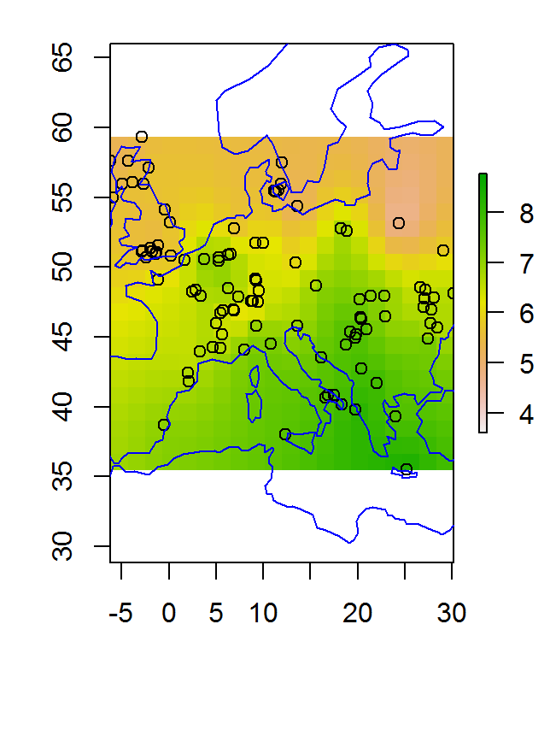
TODAY’s PRACTICALS
SPATIAL & SPATIO-TEMPORAL
In geoR….
Spread of Agriculture
Swiss Rainfall Data

Slide 13

geostatistics
SPATIAL & SPATIO-TEMPORAL
Stochastic (random) process - Variable of interest, Z, at locations set (s) within total space D
Swiss Rainfall Data
$$\left\{Z\left(s\right):s∈D\right\}$$
Locations s at which data could occur vary continuously over D.
But data are observed at a finite number of locations, denoted by:
z = {z(s₁), …, z(s_{m})}
i.e. a particular realisation of random variables Z(s)
Notes:
Spatial random field – treat variation as if it were random – probabilistic framework

Slide 14
geostatistics
SPATIAL & SPATIO-TEMPORAL
Stochastic (random) process: Variable of interest, Z, at locations (s) within total space D
Swiss Rainfall Data
$$\left\{Z\left(s\right):s∈D\right\}$$
Locations s at which data could occur vary continuously over D.
But data are observed at a finite number of locations, denoted by:
Data are observed at m locations:
What drives variation in Z?
Often want to predict the unknown stochastic process at locations where we have not sampled – i.e. produce a map across domain D.
z = {z(s₁), …, z(s_{m})}

Slide 15
STATIONARITY
SPATIAL & SPATIO-TEMPORAL
Data are observed at m locations but we often want to predict the unknown stochastic process at locations where we have not sampled – i.e. produce a map across domain D.
BUT we only have one REALISATION – inference requires many realisations
We must make some assumptions to simplify
STATIONARITY – such that each observation can be treated as a random variable
Strict stationarity – all characteristics of the random function remain the same (not practicable)
Weak/Intrinsic stationarity – certain moments are invariant, whereas others are allowed to vary
Put simply, the process Z(s) has the same degree of variation from place to place
These assumptions underlie the theoretical variogram
e.g. Oliver & Webster 2014 Catena

Slide 16
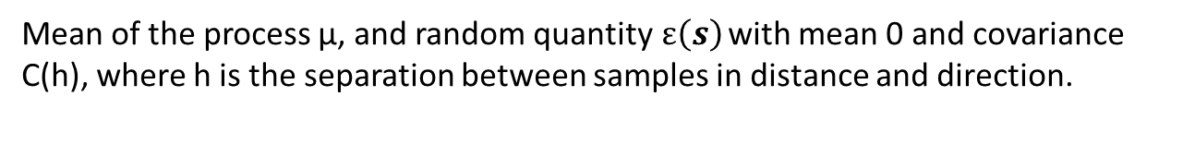

RANDOM PROCESS MODEL
SPATIAL & SPATIO-TEMPORAL
$$Z\left(s\right)= µ+ ε(s)$$
Mean of the process µ, and random quantity$ε\left(s\right)$ with mean 0 and covariance C(h), where h is the separation between samples in distance and direction.
$$C(h) = E[Z\left(s\right)Z\left(s+h\right)−µ2]$$
e.g. Oliver & Webster 2014 Catena

Slide 17
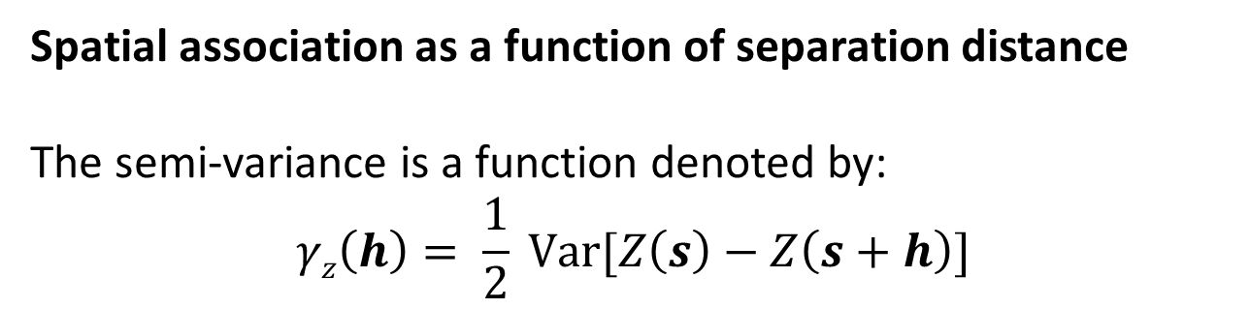
THE VARIOGRAM
SPATIAL & SPATIO-TEMPORAL
Spatial association as a function of separation distance
The semi-variance is a function denoted by:
$$γz\left(h\right)= \frac{1}{2} Var[Z\left(s\right)−Z\left(s+h\right)]$$
Variance in difference in the process Z between two locations – when this is small, locations are spatially correlated
Semi-variance depends only on h (separation) – as a function of h, it is the variogram

Slide 18
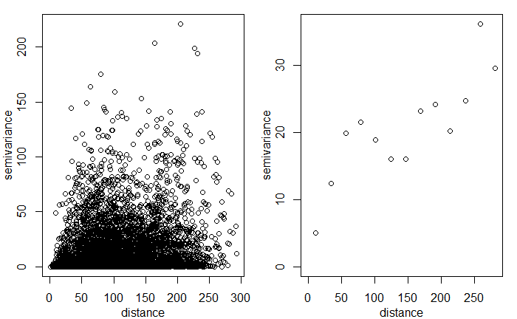
EXPERIMENTAL VARIOGRAM
SPATIAL & SPATIO-TEMPORAL

Slide 19
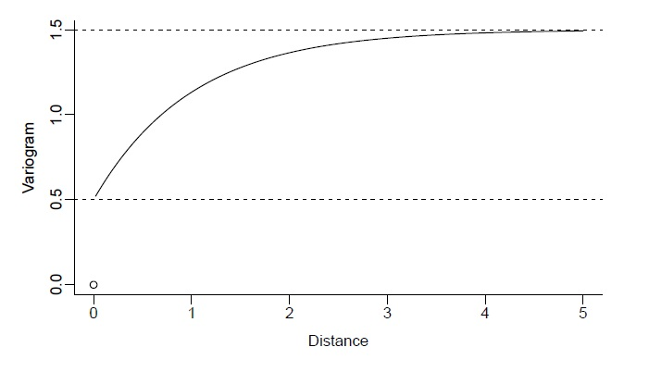
THE VARIOGRAM
SPATIAL & SPATIO-TEMPORAL
Theoretical shape of the variogram
SILL (max variance between two zs)
NUGGET (intercept - limiting value towards 0)
PARTIAL SILL (sill minus nugget)
RANGE (distance at which sill is reached)
Notes:
These are the parameters

Slide 20
PARAMETRIC MODELS OF THE VARIOGRAM
SPATIAL & SPATIO-TEMPORAL
Features:
Nugget – τ² [tau^2] > 0
Partial sill – σ² [sigma^2] > 0
Range parameter (rate at which covariance decays to zero) – φ [phi] > 0

Slide 21
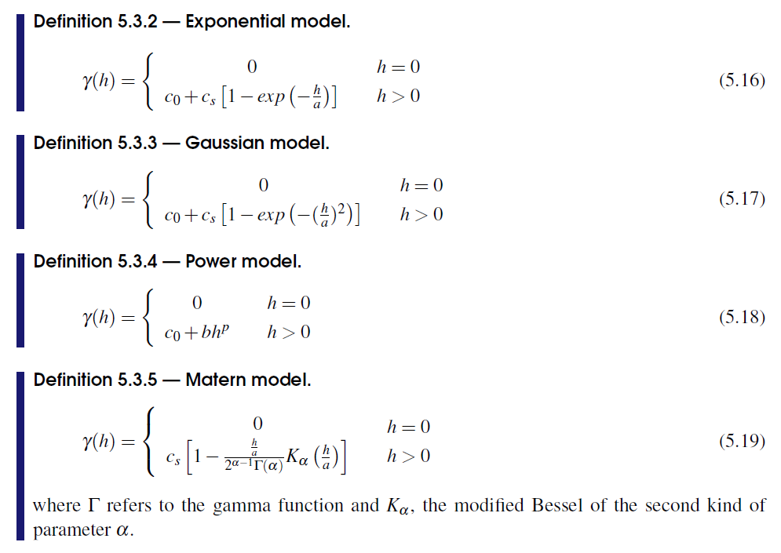
PARAMETRIC MODELS OF THE VARIOGRAM
SPATIAL & SPATIO-TEMPORAL
Some commonly used correlation functions
Caution with Gaussian – can lead to bizarre predictions (Wackernagel 2003)
Choice of function -> influence results
Floch 2018 Handbook of Spatial Statistics
Notes:
Let’s do Practical 2 up to Model estimation

Slide 22
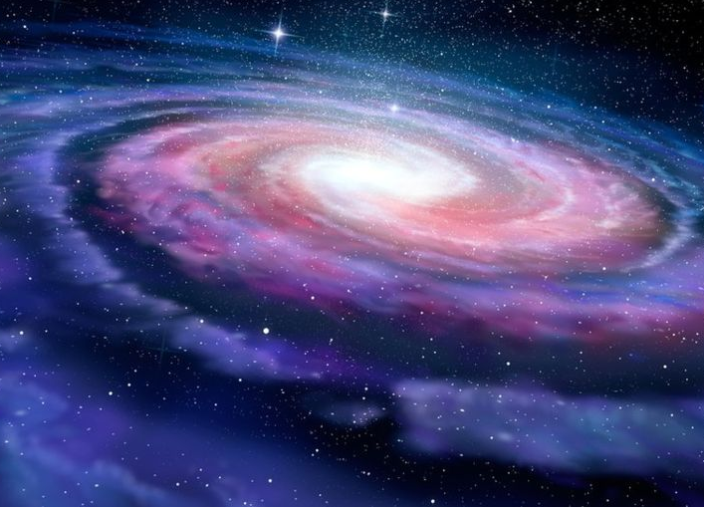

Slide 23
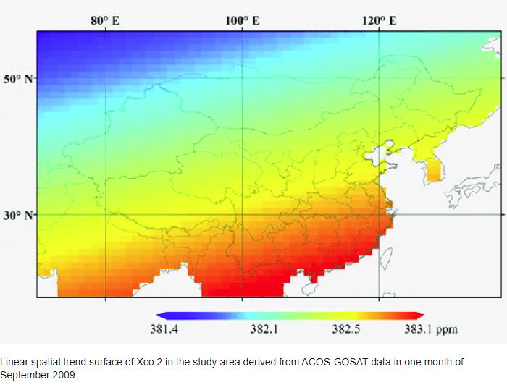
TRENDS IN SPATIAL DATA
SPATIAL & SPATIO-TEMPORAL
Recall stationarity assumption….
Gradual variation/large-scale variation
Modelled using covariates or coordinates
Then, in essence, just modelling the residual spatial variability with the variogram
Zeng et al. 2014 Transactions on Geoscience and Remote Sensing

Slide 24
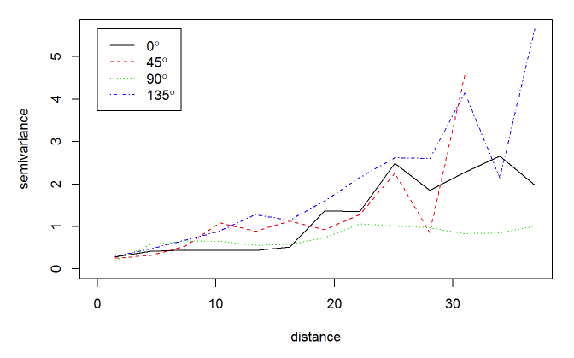
ISOTROPY
SPATIAL & SPATIO-TEMPORAL

Slide 25
Bayesian GEOSTATISTICAL MODEL
SPATIAL & SPATIO-TEMPORAL
Data:
z = {z(s₁), …, z(s_{m})}
Gaussian model with likelihood:
z ~ N(Xβ, Σ(θ))
Where the mean function Xβ is a linear combination of known covariates (X) and Σ(θ) is m x m covariance matrix for the m observations, determined by a stationary and isotropic covariance function.
The unknown parameters are Θ = (β, σ² , φ, τ² , κ²)
Joint distribution:
f(Θ) = f (β, σ² , φ, τ² , κ²)

Slide 26
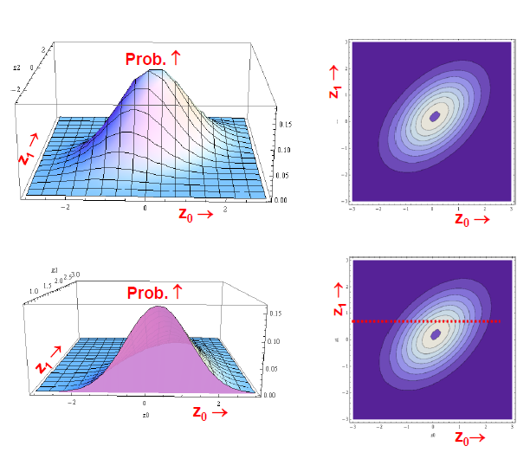
Bayesian GEOSTATISTICAL MODEL
SPATIAL & SPATIO-TEMPORAL
Multivariate Gaussian distribution
Data:
z = {z(s₁), …, z(s_{m})}
Gaussian model with likelihood:
z ~ N(Xβ, Σ(θ))
Where the mean function Xβ is a linear combination of known covariates (X) and Σ(θ) is m x m covariance matrix for the m observations, determined by a stationary and isotropic covariance function.
Unknown parameters Θ = (β, σ² , φ, τ² , κ²)
Joint distribution:
f(Θ) = f (β, σ² , φ, τ² , κ²)

Slide 27
Bayesian GEOSTATISTICAL MODEL
SPATIAL & SPATIO-TEMPORAL
Data:
z = {z(s₁), …, z(s_{m})}
Gaussian model with likelihood:
z ~ N(Xβ, Σ(θ))
Where the mean function Xβ is a linear combination of known covariates (X) and Σ(θ) is m x m covariance matrix for the m observations, determined by a stationary and isotropic covariance function.
The unknown parameters are Θ = (β, σ² , φ, τ² , κ²)
Joint distribution:
f(Θ) = f (β, σ² , φ, τ² , κ²)
DATA + PRIORS -> POSTERIOR

Slide 28
PLAUSIBLE PRIORS
SPATIAL & SPATIO-TEMPORAL
Take on any value
Must be positive
Inverse-Gamma conjugate for variance. Choice of (a,b) under research/debate.
Chosen over likely range of correlations
β ~ N(µ_{β}, V_{β})
σ² , κ² ~ Uniform(0, *large) or
σ² , κ² ~ Inverse-Gamma(a, b)
φ ~ Uniform(c, d)

Slide 29
Why ‘go Bayesian’…
SPATIAL & SPATIO-TEMPORAL
…FOR GEOSTATISTICAL ANALYSIS
Correctly allows for variation in the parameters - Parameters of correlation function – random, not fixed (have an associated probability distribution)
Uncertainty intervals are easy to obtain for all parameters, not just regression parameters
Appropriate propagation of uncertainty means prediction intervals will be wider

Slide 30
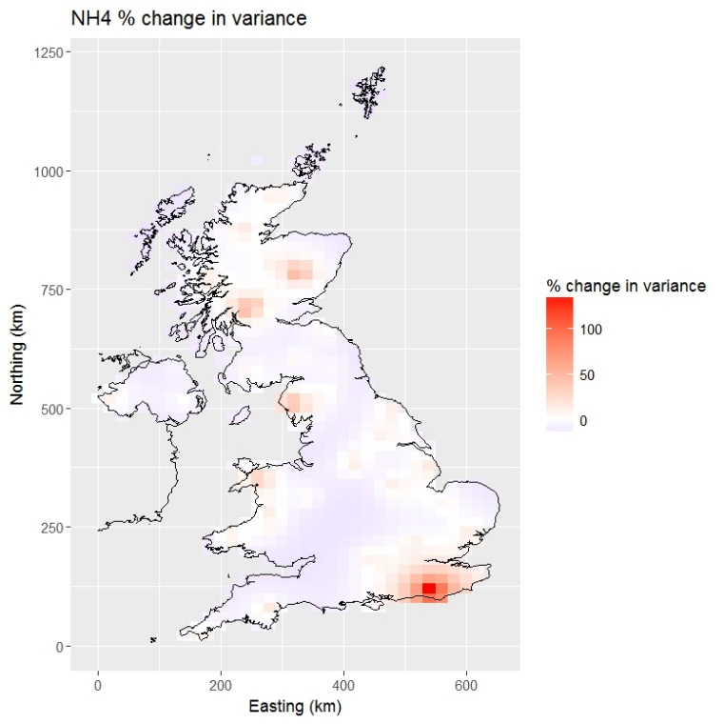
Q: What is the impact of losing 6 sites from an air pollution monitoring network?
SPATIAL & SPATIO-TEMPORAL
Change in estimated ammonium concentration (mean)
Change in variance of ammonium predictions

Slide 31
Q: What is the impact of losing 6 sites from an air pollution monitoring network?
SPATIAL & SPATIO-TEMPORAL
Generalise: Impact of sample size on spatial interpolation
Change in estimated ammonium concentration (mean)
Change in variance of ammonium predictions

Slide 33
ESTIMATING THE MODEL
SPATIAL & SPATIO-TEMPORAL
Krige.bayes function
model.control
prior.control
Data - how are they distributed; do we have covariates?
Mean - constant; trends
Covariance model
Priors – which are fixed, which are random, which distribution?

Slide 34
ESTIMATING THE MODEL
SPATIAL & SPATIO-TEMPORAL
Krige.bayes function
model.control
prior.control
output.control
Data - how are they distributed; do we have covariates?
Mean - constant; trends
Covariance model
Priors – which are fixed, which are random, which distribution?
Posterior distribution for each parameter
Predictive distribution for each location
From which we can map the mean, variance etc…

Slide 35
SUMMARY
SPATIAL & SPATIO-TEMPORAL
In environmental data, things most often positively correlate in space
Reflecting underlying processes and (un)measured data
This may be of interest or a dependence for which we need to account
Computational power is allowing us to do this in more sophisticated ways
In Bayesian geostatistics the variogram parameters are random (defined by a probability distribution), not fixed (single value)
As such we can propagate and more thoroughly estimate uncertainty, which may inform model selection as well as inference

Slide 36
RESOURCES
SPATIAL & SPATIO-TEMPORAL
Banerjee & Fuentes (2012) Bayesian Modelling for Large Spatial Datasets. Wiley Interdiscip Rev Comput Stat. 4(1): 59–66.
Oliver & Webster (2014) A tutorial guide to geostatistics: Computing and modelling variograms and kriging. Catena 113: 56-69
Ribeiro et al. (2003) Geostatistical software – geoR and geoRglm. DSC 2003 Working Papers
Ribeiro & Diggle Technical Report ST-99-08: Bayesian inference in Gaussian model-based geostatistics
See also references in Spatio-temporal slides

Slide 37
Supplementary slides

Slide 38
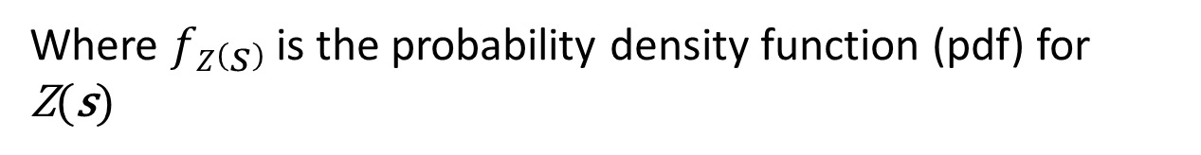
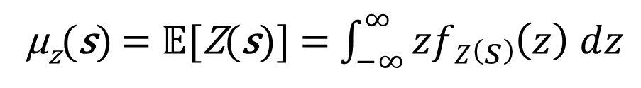
geostatistics
SPATIAL & SPATIO-TEMPORAL
The mean function – the expected value at location s from the distribution of all possible values generated from stochastic process Z(s)
µ_{z}(s) = 𝔼[Z(s)] s ∊ D
When Z(s) is a continuous random variable:
µ_{z}(s) = 𝔼[Z(s)] = $\int_{−∞}^{∞}{zfZ\left(s\right)\left(z\right) dz}$
Where $fZ\left(s\right)$ is the probability density function (pdf) for Z(s)

Slide 39
geostatistics
SPATIAL & SPATIO-TEMPORAL
The covariance function – covariance measures strength of linear dependence between two random variables (Z(s) and Z(t))
C_{z}(s,t) = Cov[Z(s), Z(t)]
C_{z}(s,t) = 𝔼[(Z(s) - µ_{z}(s))(Z(t) - µ_{z}(t)) ]
The variance function of Z(s) is the special case of the covariance s=t, giving:
Var[Z(s)] = Cov[Z(s), Z(s)]
= 𝔼[(Z(s) - µ_{z}(s))² ]
= ε²_{Z}(s)

Slide 40
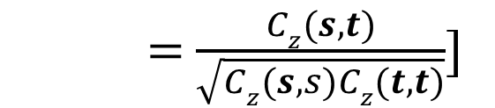
geostatistics
SPATIAL & SPATIO-TEMPORAL
The correlation function – the strength of association between two random variables (Z(s) and Z(t)) is simply a scaled version of the covariance function:
ρ_{z}(s,t) = Corr[Z(s), Z(t)]
= $\frac{Cz(s,t)}{\sqrt{Cz(s,s)Cz(t,t)}}$]

